Slide 1
Speeder
By: Michael Molnar (100806823)
Hibba Imtiaz (100794061)
Faizan Ali (100518916)
Utsav Vanodiya (100804273)
Optimal Route Planning made easy.
Save Time and Money, leave the heavy lifting to us

Slide 2
Contents
Problem Statement
Understanding the Problems
Project Objective
AI Approaches and Technologies
Target Audience
Features
Use Cases
Cycle Diagram

Slide 3
Problem Statement
With the increasing complexity of the roads, it is becoming difficult to choose the fastest path that not only gets you to your destination on time but also decreases the cost consumption.
More often than not, finding a destination indoors can get more complex than the outdoors, where the buildings have complex floor plans.
With that in mind, we aim to develop a product that will generate optimal paths outdoors and indoors.

Slide 4
Understanding the Problems
01
Planning a route from one location to another is very easy using Google Maps, the challenge comes when you have multiple stops. You not only need to figure out the optimal route from point A to B, but also the optimal order to visit each point.
02
If you have a company that requires employees to do regular travelling to multiple destinations, you not only want to get to your destination quickly but also figure out a way to save on cost. You need to figure out who to send where and if you need to go with a one to one or one to many approach.
03
Sometimes you need to go to a large indoor location, for which map data is not available and requires an alternative method to get the location data needed to determine the optimal path

Slide 5
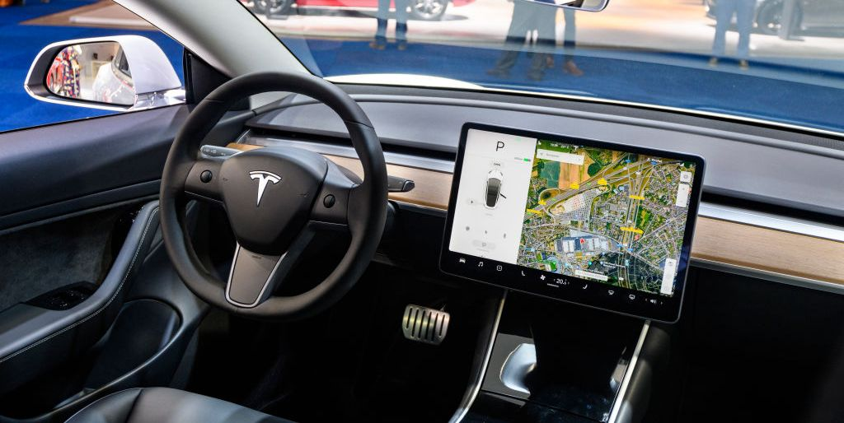
Project objective
Automatically plan optimal routes from one starting location to multiple destinations, minimizing time and cost for the business.

Slide 6
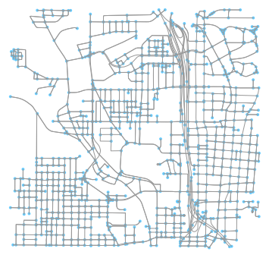
AI Approaches and Technologies
There are a few approaches we will explore to determine optimal paths:
Search algorithms such as A* and Dijkstra’s Algorithms
Q-Learning (Reinforcement Learning)
Genetic Algorithms combined with Deep Learning Neural Networks
We will use a graph structures to model the map. To obtain these we will use OpenStreetMap and the Python package, OSMnx.
User Interaction:
Android/Web application
Deployment/Server
Cloud based server to host the optimal path algorithm
Host app on play store/speeder website

Slide 7


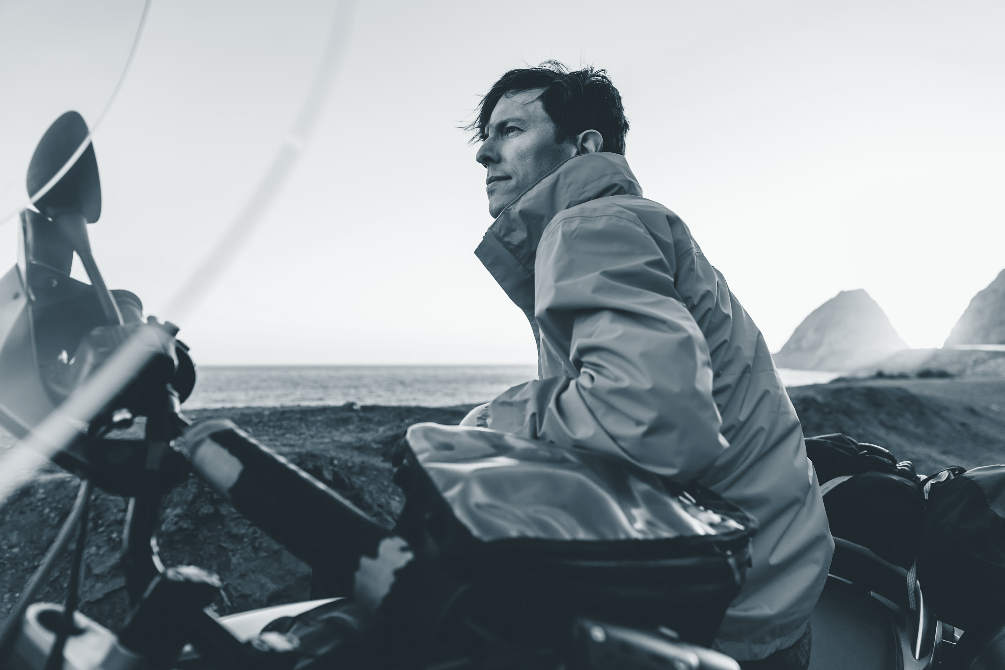
Target audience
Small and large businesses as well as individuals that require a lot of travelling on a regular basis.

Slide 8
Features
Providing an AI solution that will schedule the employee shifts to cut down on cost consumption.
Calculating the gas consumption based on the car model.
Indoor mapping of complex areas that generates a path to reach the destination quickly.
Getting feedback from the user based on their experience and improving on it.
Optional (Time Permitted):
Using Object detection to find an alternative route indoors.
Detect closed routes
Obstacles in the path
Add augmented reality and location tracking for indoor navigation.

Slide 9
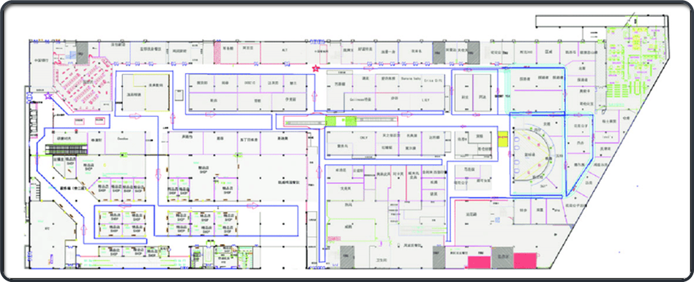
Use Cases
The user will enter their starting location their destinations, and the number of drivers that are available.
Generate optimal their route based on time or on costs such as gas consumption.
The app will display a street map with the optimal order and paths indicated, as well as recommendations on who to send where.
Upon arriving at the destination, if it is a location for which we have an indoor floor plan, the user will be able to select their destination and a path will be provided.

Slide 10
Cycle diagram
04
Prototype Optimal Path
Refine
Optimize the application based on current feedback and testing of the application.
Generate optimal paths based on user starting location and destinations for indoor and outdoor locations
01
03
Build frontend
Get feedback
Make an application the user can easily use to get custom paths for their application
Implement features to get user feedback on the application and features they would like added. Run tests on full application
02

Slide 11
Thank you!

